Slide 1
University of Basrah – College of veterinary Medicine
Department of Vet. Surgery and Obstitric
Affection Of the Penis & prepuce
Dr.Alaa A. Ibrahim

Slide 2
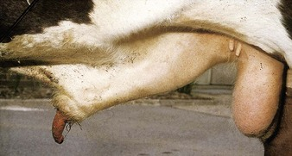
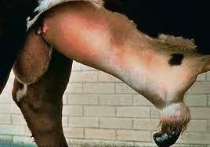
Penile hematoma
It is commonest penile lesion or its sequelae (abscess or adhesion)
Results from sudden or forceful bending of the erect penis
Penile deviation occur by sudden movement of the cow or by thrusting of the bull against the thigh of the cow before intromission is achieved, results in rupture of the tunica albuginea and hemorrhage
Repeated mating attempts by the bull may exacerbated hematoma
Hematoma site is distal to the distal curve of sigmoid flexor which is site of attachment of retractor penis M

Slide 3
The swelling located just cranial to the scrotum , reflecting the position of rupture site on partially withdrawn penis.
In some cases paraphimosis (inability withdraw the penis itself back into the prepuce)
Prognosis and clinical approach are influence by the size of hematoma
If the swelling is less than 15 cm in diameter , surgery is usually not required and the bull have a good prognosis for return to normal service behavior with conservative therapy
Conservative therapy include :removing bull from cow for 6 weeks, daily hydrotherapy with cold water in acute stage after injury (4 days ) and warm water thereafter , coupled with vigorous massage in a deliberate attempt to move the skin , intervening layers of fascia, and the penis to minimize formation of adhesions between these structures, are recommended.

Slide 4
Hydrotherapy and massage should be continued for 3 weeks and NSAID may be beneficial first week.
Hematoma is over 15 cm in diameter, more extensive damage to the penile adnexa results, making restrictive adhesion formation and increase risk of abscess
These factors make prognosis and surgical therapy poor
Skin incision is should be small because large incision allow more opportunities for firm adhesion between skin and underlying tissue
Blood, blood clots, and serum are gently removed, with attention paid to hemostasis.
Any detectable rent in the tunica albuginea sutured with absorbable material, with care taken to avoid penetrating suture bites through the tunica albuginea which may result in leakage and failure to maintain erection

Slide 5
The skin incision should be left open. Postsurgical treatment should parallel the conservative approach to smaller hematomas.
Recurrence of the injury is common
Complications
Abscessation or extensive adhesions.

Slide 6
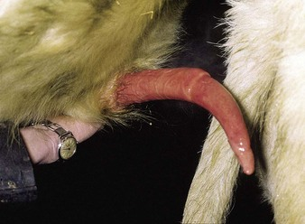
Deviation of the penis (corkscrew penis)
Most common form is spiral deviation
This condition result from slippage of apical ligament of the penis during erection , but before intromission .
Apical ligament is a thickened fibrous band located dorsally near the free end of the penis
This ligament helps to hold penis straight for intromission and slips to the side after ejaculation and causes spiral deviation of the tip of the penis
Bull do not demonstrate this deviation
at every service attempt but may
prevent intromission in 50%-100%
attempts

Slide 7
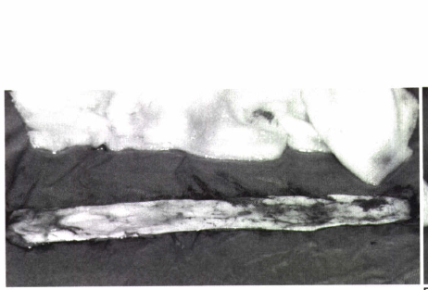
Diagnosis :- Only by observation of service attempts.
Treatment
Surgical treatment involve anchoring the apical ligament of the penis so it cannot slip laterally or augmenting the apical ligament with an implant
For implantation, one large or multiple thin strips of fascia lata may be used; alternatively, synthetic fibers may be implanted.

Slide 8
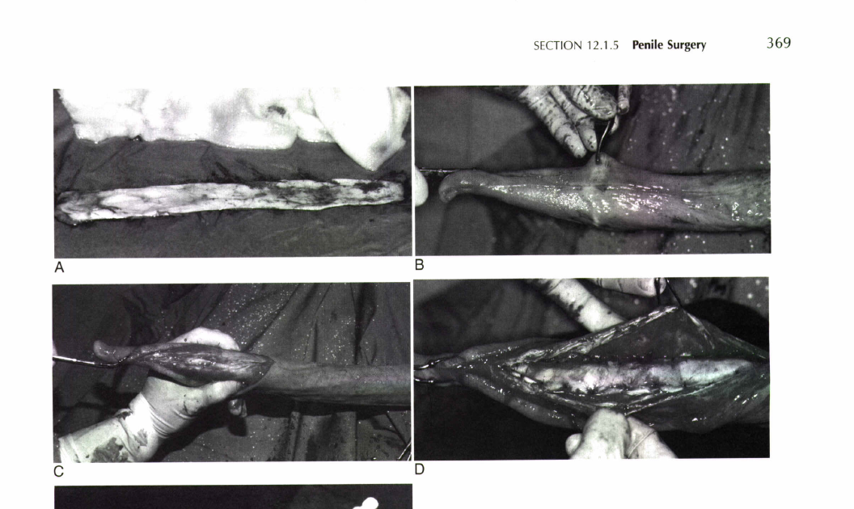
The penis is extended and held in place with penetrating towel clamps carefully placed into the distal part of the apical ligament to avoid penetration of the tunica albuginea
A longitudinal incision is made along the dorsal aspect of the penis
The incision is deepened until the apical ligament is exposed
The free edges of the apical ligament are identified, and carefullly tacked to the underlying tunica albuginea, using multiple simple interrupted sutures of synthetic absorbable material.

Slide 9
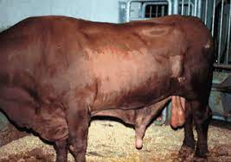
Erection failure
Result from leakage from corpus cavernosum penis which is a well-described cause of impotence in bull(impede erection.)
Vascular shunts usually communicate with the superficial penile vessels, but in some cases communication between the corpus cavernosum penis and corpus spongiosum penis occur
Cavernosal shunt must be differentiate from ventral deviation of the penis (rainbow penis ) which is result from defect of the apical ligament of the penis.
In erection failure the penis
is usually extended normally ,
but erection is maintained only
momentarily before the penis
becomes flaccid and droops.
In the ventral deviation of the penis , the penis does not achieve its full length while straight and it remain rigid

Slide 10
Etiology of erection failure
Congenital presence of communicating vessel
Traumatic or iatrogenic penetration of the corpus cavernosum
Treatment
If there is communication between corpus cavernosum and corpus spongiosum , surgery is impossible
If the communication is with a superficial vessel, this vessel can be identified at surgery and firmly ligated at its point of emergence from the corpus cavernosum penis
For success of the corrective operation , 2-3 ml of dye (e.g methylene blue) can be injected slowly in the corpus cavernosum .

Slide 11
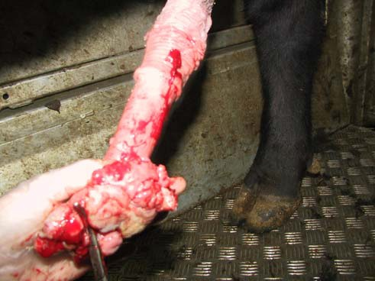
Penile tumors
Most common bovine penile tumor is fibropapiloma
Fibropapiloma interfere with breeding make intermission impossible in some cases and uncomfortable in other
Bleeding interfere with semen quality
Surgical remove of fibropaploma to provide a rapid and certain return to use

Slide 12
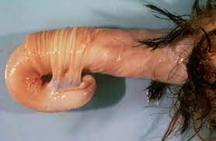
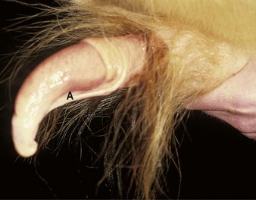
Persistent penile frenulum
Congenital band of connective tissue located between the glans penis and the prepuce (ventrum of the penis that extends from the prepuce to near the tip of the free portion of the penis)
Does not break down as the bull reach the puberty
Separation occurs at the time of puberty, starting from the tip of the penis and progressing caudally usually complete at 9 months of age.
The persistent frenulum prevent straight extension of the penis and during erection the elongated penis is pull into bow shape
Persistent frenulum is inherited disorder and can pass on to progeny

Slide 13
Treatment of Persistent penile frenulum
By transection of the persistent frenulum .Before transection , ligation of large vessel.
In young bull , penis often can be extended manually without or with little sedation. Application of dorsal nerve block is sufficient for perform this procedure.

Slide 14
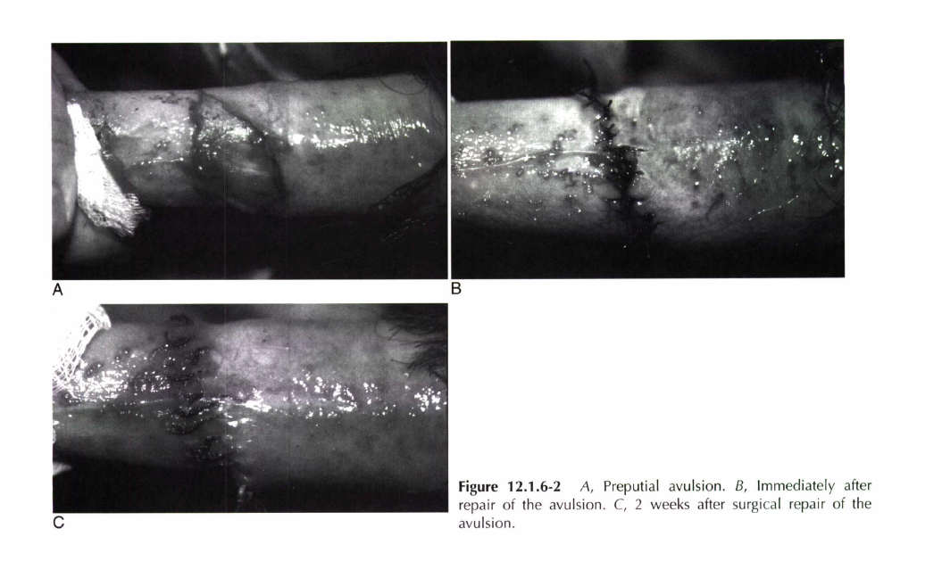
Preputial avulsion
Avulsion of the lamina interna of the prepuce from its attachment to the penile integument at the fornix or point of reflection
Injury is costly because it causes temporary suspension of semen collection
Etiology is not fully understood and occur in young bulls newly introduced for semen collection or reintroduced after a period of layoff
Observed only in bull whose semen is collected by artificial vagina

Slide 15
Sign : Bleeding after semen collection
Diagnosis can be confirmed by extending and examining of the penis (penis manually exteriorized after administration of 5mg xylazine )
Treatment
The injury may left to heal by second intension but convalescence is prolonged
Surgery is performed immediately after injury (on the same day) in order bull return to use with
few complications
Bull isolated from other bulls
and cows sexual stimulation
which provoke dehiscence of
surgical site

Slide 16
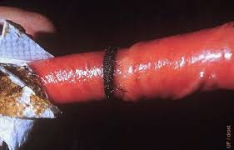
Preputial hair ring
Ring of preputial hair may entrap the penis
This condition is usually spontaneously resolved but the hair may strangulate and damage the penis
Treatment of the lesion is depend on the judge of the surgeon but some cases may treated as preputial avulsion

Slide 17
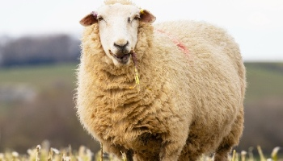
Preputial erosion
Decubital lesion occur dorsal to preputial orifice between the prepuce and abdominal wall
Affect heavy show rams because they are recumbent much of time , pressure of the preputial orifice on abdominal wall results in a chronic ulcer.
This erosion is resistant to conservative treatment and only surgical resection is treatment option.

Slide 18
Preputial abscess
Retropreputial abscess may follow injury of lamina interna of prepuce
Result from preputial avulsion or penile hematoma
drain into preputial cavity but when the swelling often prevent exteriorization of the penis and access , therefor the abscess must be drained by skin incision.

